Slide 1



CSA5116 – Cryptography and Network Security
Explanation of Substitution Technique and their types
By:
Deva G (192421344)
Name of the Guide:
Dr. E. Anbalagan

Slide 2





Introduction
Plaintext are replaced by other letters or by numbers or symbols.
Substitution Technique:
i) Monoalphabetic Substitution Technique
Caesar Cipher
Monoalphabetic Substitution
ii) Polyalphabetic Substitution Technique
Viegnere cipher
Playfair cipher
Hill cipher

Slide 3
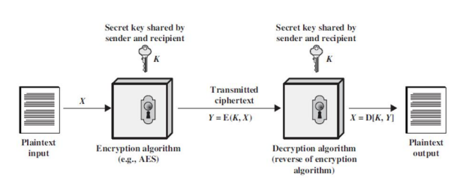
Encryption and Decryption Techniques

Slide 4


Caesar Cipher
Plain text: GOODMORNING
Key: 3
Encrypted text / Cipher text: JRRGPRUQLQJ
Key: 3
Decrypted text / original text: GOODMORNING
Formula:

Slide 5
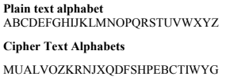
Monoalphabetic Substitution

Slide 6
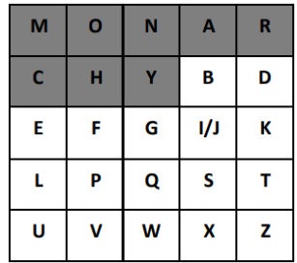
PlayFair Cipher
In this technique, multiple of 2 letter are encrypted at a time.
5x5 matrix it should be in.
Rules:
Same letter should not be same.
Should be in same rows.
Should be in same column.
Should contain in different row and different column.
Key word: Monarchy
Plain Text: instrument
Cipher text: ?

Slide 7
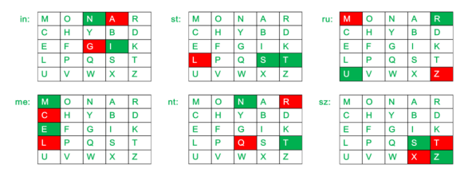
PlayFair Cipher

Slide 8
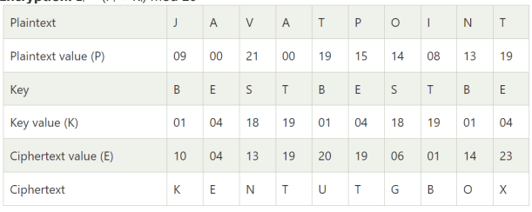
Viegnere Cipher
Key word: BEST
Plain Text: JAVATPOINT
Cipher text: ?

Slide 9


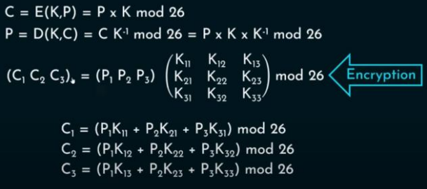
Hill Cipher
Formula:

Slide 10
Thank you

